Slide 1
UFCFVK-15-2 Internet of Things

Slide 2
Introduction to Communication Systems and Networks

Slide 3
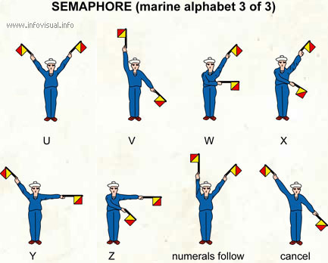
Telecommunications
Tele (Far) + Communications
Early telecommunications
smoke signals and drums
visual telegraphy (or semaphore in 1792)
Telegraph and telephone
Telegraph (1839)
Telephone (1876)
Radio and television
Telephony
Voice and Data

Slide 4
Communications and Networks
Data Communications
Transmission of signals
Encoding, interfacing, signal integrity, multiplexing etc.
Networking
Topology & architecture used to interconnect devices
Networks of communication systems

Slide 5
Voice, Image, Data, Video
Microcontroller
Networking
Wireless
Integrated Systems!

Slide 6
Communication Systems
Process describing transfer of information, data, instructions between one or more systems through some media
Examples
people, computers, cell phones, etc.
Computer communication systems
Signals passing through the communication channel can be Digital, or analog
Analog signals: continuous electrical waves
Digital signals: individual electrical pulses (bits)
Receivers and transmitters: desktop computers, mainframe computers, etc.
Communication channel
TX
RX
An amplifier is an electronic device that increases the voltage, current, or power of a signal. Amplifiers are used in wireless communications and broadcasting, and in audio equipment of all kinds
RX
RX
Amp/Adaptor
Communication
media

Slide 7
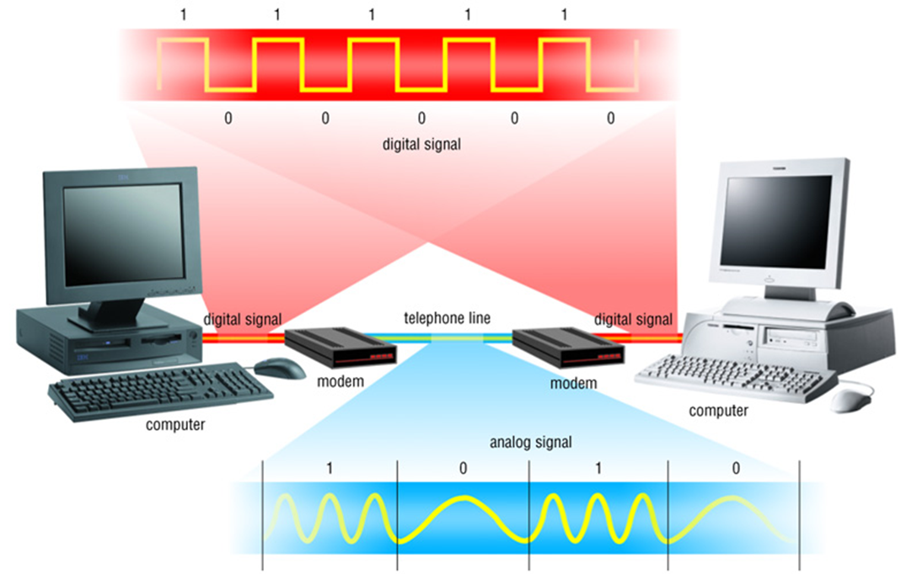
Communication Systems

Slide 8
Communications Components
Basic components of a communication system
Communication technologies
Communication devices
Communication channels
Communication software

Slide 9
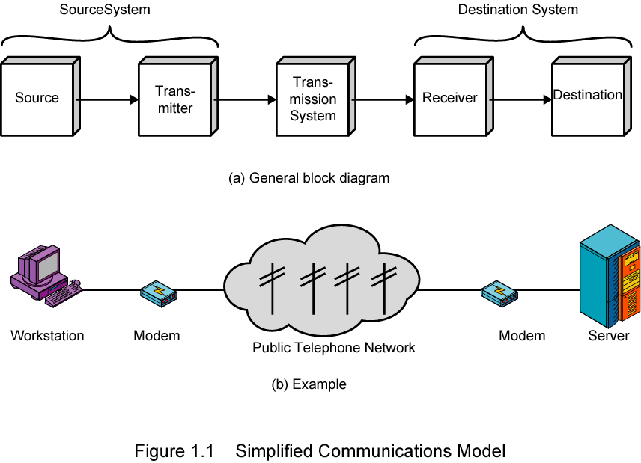
A Communications Model

Slide 10
Communications Tasks
Transmission system utilization | Addressing
Interfacing | Routing
Signal generation | Recovery
Synchronization | Message formatting
Exchange management | Security
Error detection and correction | Network management
Flow control

Slide 11
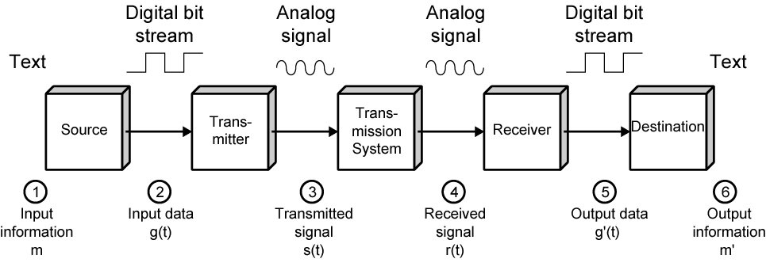
Data Communications Model

Slide 12
Communication Technology Applications
voice mail
Twitter
e-mail
instant messaging
chat rooms
newsgroups
telephony
videoconferencing
collaboration
groupware
global positioning system (GPS)

Slide 13
Communication Technologies – Applications 1
Different technologies allowing us to communicate
Examples: Voice mail, email, instant message, chat rooms, news groups, telephony, GPS, and more
Voice mail: Similar to answering machine but digitized
Email: electronic mail – sending text, files, images between different computer networks - must have email software
More than 1.3 billion people send 244 billion messages monthly!

Slide 14
Communication Technologies – Applications 2
Chat rooms: Allows communications in real time when connected to the Internet
Telephony: Talking to other people over the Internet (also called VoIP)
Sends digitized audio signals over the Internet
Requires Internet telephone software
Groupware: Software application allowing a group of people to communicate with each other (exchange data)
Address book, appointment book, schedules, etc.
GPS: consists of receivers connected to satellite systems
Determining the geographical location of the receiver
Used for cars, advertising, hiking, tracking, etc.

Slide 15
Communication Devices 1
Any type of hardware capable of transmitting data, instructions, and information between devices
Functioning as receiver, transmitter, adaptor, converter
Basic characteristics: How fast, how far, how much data!
Examples: Dial-up modems, ISDN, DSL modems, network interface cards
Dial-up-modem uses standard phone lines
Converts digital information into analog
Consists of a modulator and a demodulator
Can be external, internal, wireless
ISDN and DSL Modem: Allows digital communication between networks and computers
Requires a digital modem
Digital is better than analog – why?

Slide 16
ISDN : Integrated Services Digital Network.
It is used to bridge the Central Office's local loop and the premise connection (home). ISDN uses the existing wiring so that no new cabling is required. It is a digital service that restores the analog plain old telephone set.
An Integrated Digital Network (ISDN) is a network in which digital switching connections are used to transmit digital signals. Integrated Services refers to ISDNs ability to deliver two simultaneous connections, in any merging of data, voice, video and fax, over an individual line. Multiple devices can be connected to the line and sent as needed.
An ISDN is a network, in general evolving from telephony ISDN, which provides end-to-end digital connectivity to provide a broad range of services such as voice and non-voice services, to which customers have to create by a limited set of standard multipurpose user network interfaces.

Slide 17
It offers symmetrical transfer rates− the transmit rate is the same as the receiving rate.
It has consistent transfer rates. If you have a 64 Kbps bearer channel, then it is the speed that you transfer at.

Slide 18
Communication Devices 2
Examples: Dial-up modems, ISDN, DSL modems, network interface cards
Cable modem: a modem that transmits and receives data over the cable television (CATV) network
Also called broadband modem (carrying multiple signals)
The incoming signal is split
Requires a cable modem
Network interface cards: Adaptor cards residing in the computer to transmit and receiver data over the network (NIC)
Operate with different network technologies (e.g., Ethernet)

Slide 19
Communication Software
Examples of applications (Layer 7) take advantage of the transport (Layer 4) services of TCP and UDP
Hypertext Transfer Protocol (HTTP): A client/server application that uses TCP for transport to retrieve HTML pages.
Domain Name Service (DNS): A name-to-address translation application that uses both TCP and UDP transport.
Telnet: A virtual terminal application that uses TCP for transport.
File Transport Protocol (FTP): A file transfer application that uses TCP for transport.

Slide 20
Port numbers

Slide 21
Communication Software
Examples of applications (Layer 7) take advantage of the transport (Layer 4) services of TCP and UDP
Trivial File Transfer Protocol (TFTP): A file transfer application that uses UDP for transport.
Network Time Protocol (NTP): An application that synchronizes time with a time source and uses UDP for transport.
Border Gateway Protocol (BGP): An exterior gateway routing protocol that uses TCP for transport. BGP is used to exchange routing information for the Internet and is the protocol used between service providers.

Slide 22
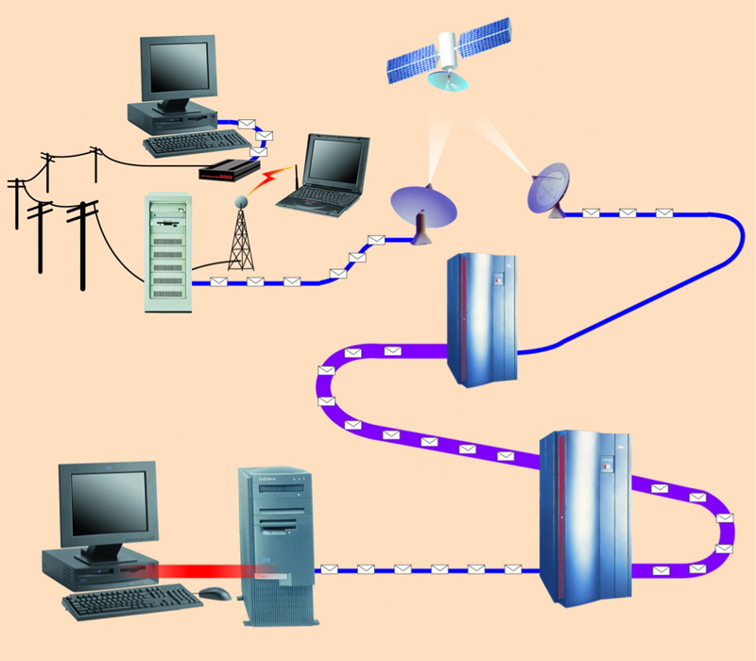
Communication Channels
A channel is a path between two communication devices
Channel capacity: How much data can be passed through the channel (bit/sec)
Also called channel bandwidth
The smaller the pipe the slower data transfer!
Consists of one or more transmission media
Materials carrying the signal
Two types:
Physical: wire cable
Wireless: Air
T1 lines
T1 lines
destination network server
T3 lines
T1 lines

Slide 23
Physical Transmission Media
A tangible media
Examples: Twisted-pair cable, coaxial cable, Fiber-optics, etc.
Twisted-pair cable:
One or more twisted wires bundled together (why?)
Made of copper
Coax-Cable:
Consists of single copper wire surrounded by three layers of insulating and metal materials
Typically used for cable TV

Slide 24
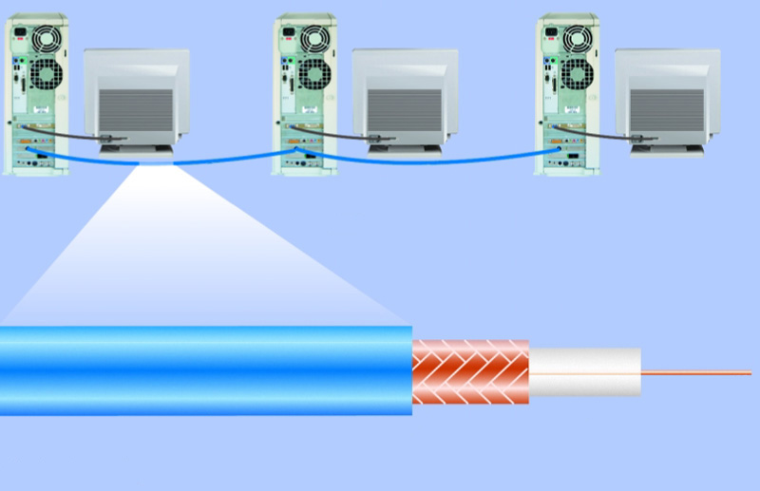
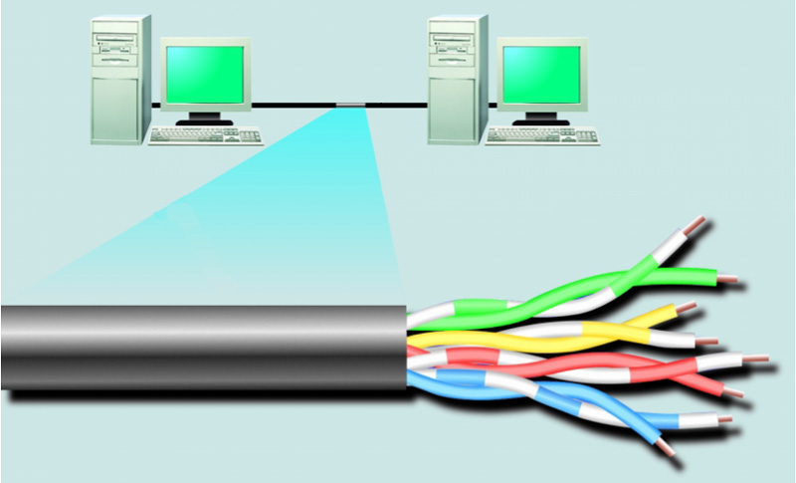
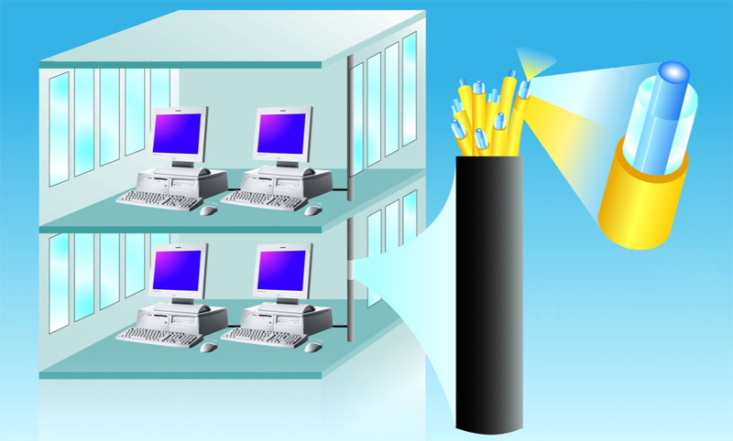
Fiber-optics:
Strands of glass or plastic used to transmit light
Very high capacity, low noise, small size, less suitable to natural disturbances
woven or braided metal
twisted-pair cable
twisted-pair wire
copper wire
plastic outer coating
insulating material
optical fiber core
glass cladding
protective coating

Slide 25
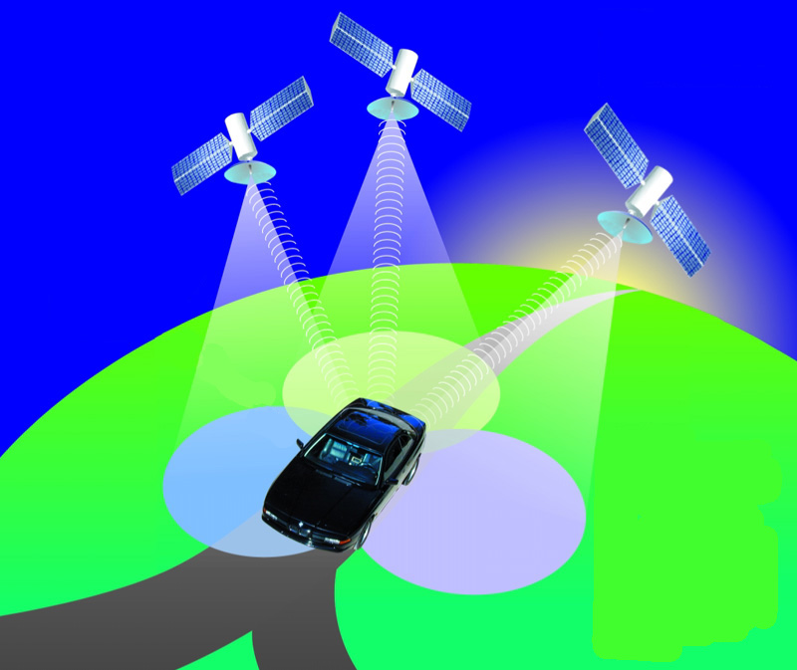
Wireless Transmission Media
Broadcast Radio
Distribute signals through the air over long distance
Uses an antenna
Typically for stationary locations
Can be short range
Cellular Radio
A form of broadcast radio used for mobile communication
High frequency radio waves to transmit voice or data
Utilizes frequency-reuse

Slide 26
Microwaves
Radio waves providing high speed transmission
They are point-to-point (can’t be obstructed)
Used for satellite communication
Infrared (IR)
Wireless transmission media that sends signals using infrared light- waves

Slide 27
Networks
Collection of computers and devices connected together
Used to transfer information or files, share resources, etc.
What is the largest network?
Characterized based on their geographical coverage, speed, capacities
Networks are categorized based on the following characteristics:
Network coverage: LAN, MAN, WAN
Network topologies: how the computers are connected together
Network technologies
Network architecture

Slide 28
Inter & Intra networks
Firewall
Internet Server
A
Other Server
Intranet Server
B
Internet
Application Server
C
X
Y
Intranet

Slide 29
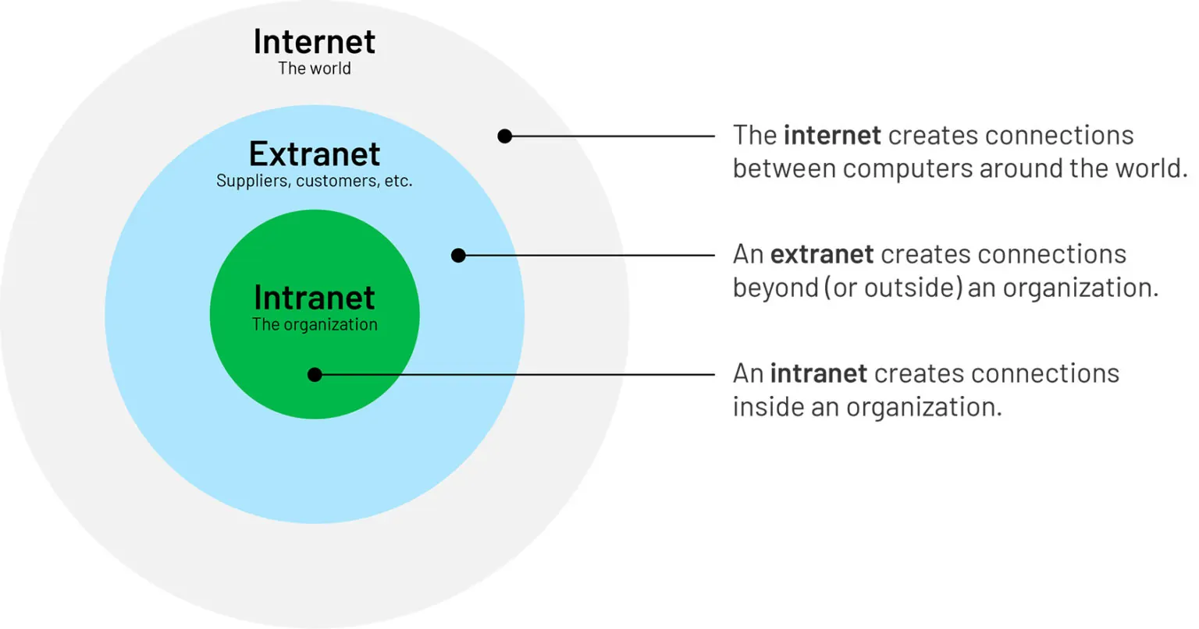

Slide 30
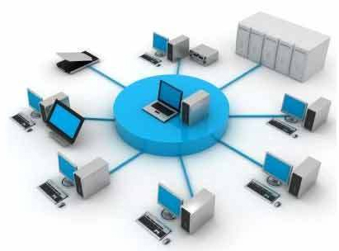
Types of Networks:
Local Area Network (LAN)
This is one of the categories of network, and one of the simplest. LAN networks connect computers together over relatively small distances, such as within a single building.

Slide 31
Wide Area Network (WAN)
This is another categories of network, and slightly more complex in nature.
WAN networks connect computers together over large physical distances, remotely connecting them over one huge network and allowing them to communicate even when far apart.
The Internet is a WAN, and connects computers all around the world together.

Slide 32
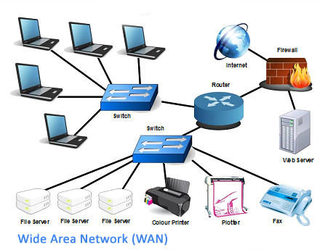
Wide Area Networks

Slide 33
Metropolitan Area Network
This is a network which is larger than a LAN but smaller than a WAN, and incorporates elements of both. It typically spans a town or city and is owned by a single person or company, such as a local council or a large company.

Slide 34
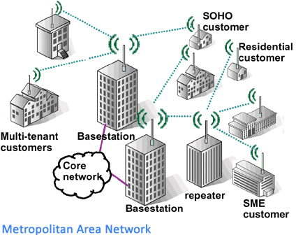
Metropolitan Area Network
Small Office Home Office
Small Medium Enterprise

Slide 35
Topologies:
Devices must be connected using the following topologies:.
Mesh topology
Star topology
Ring topology
Bus topology

Slide 36
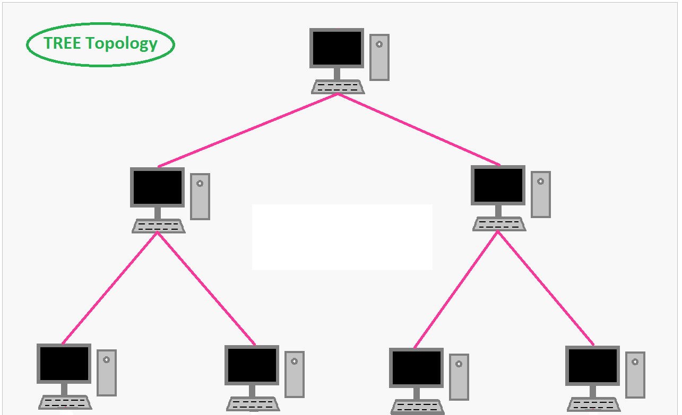

Slide 37
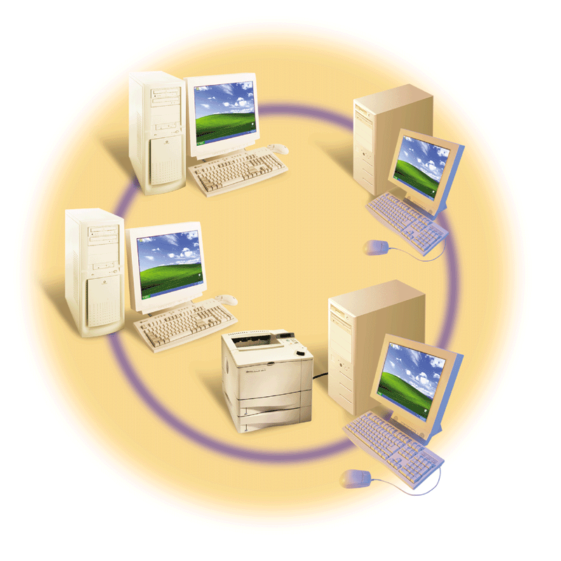
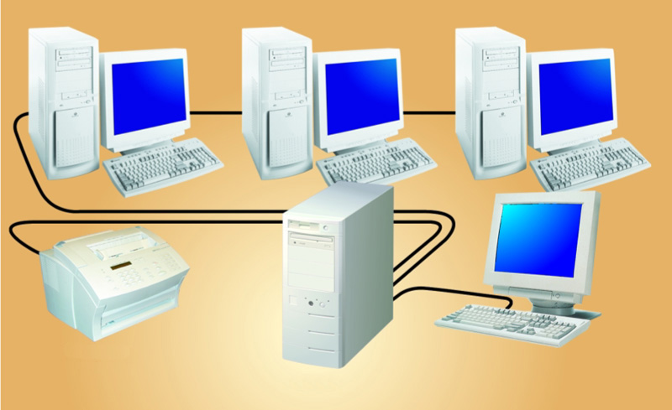
Network Architecture
Refers to how the computer or devices are designed in a network
Basic types:
Centralized – using mainframes
Peer-2-Peer:
Each computer (peer) has equal responsibilities, capacities, sharing hardware, data, with the other computers on the peer-to-peer network
Good for small businesses and home networks
Simple and inexpensive
Client/Server:
All clients must request service from the server
The server is also called a host
Different servers perform different tasks: File server, network server, etc.
client
client
client
laser printer
server

Slide 38
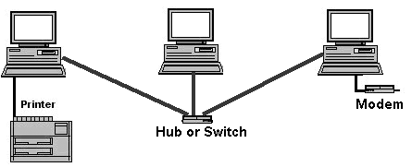
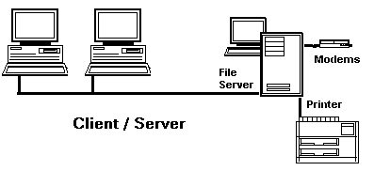
P2P vs Client-Server
Peers make a portion of their resources, such as processing power, disk storage or network bandwidth, directly available to other network participants, without the need for central coordination by servers or stable hosts
Peer-to-Peer Examples

Slide 39
(Data) Network Technologies
Vary depending on the type of devices we use for interconnecting computers and devices together
Ethernet:
LAN technology allowing computers to access the network
Susceptible to collision
Can be based on BUS or STAR topologies
Operates at 10Mbps or 100Mbps, (10/100)
Fast Ethernet operates at 100 Mbps /
Gigabit Ethernet (1998 IEEE 802.3z)
10-Gigabit Ethernet (10GE or 10GbE or 10 GigE)
10GBASE-R/LR/SR (long range short range, etc.)
Physical layer
Gigabit Ethernet using optical fiber, twisted pair cable, or balanced copper cable

Slide 40
(Data) Network Technologies
Token Ring
LAN technology
Only the computer with the token can transmit
No collision
Typically 72-260 devices can be connected together
TCP/IP and UDP
Uses packet transmission
802.11
Standard for wireless LAN
Wi-Fi (wireless fidelity) is used to describe that the device is in 802.11 family or standards
Typically used for long range (300-1000 feet)
Variations include: .11 (1-2 Mbps); .11a (up to 54 Mbps); .11b (up to 11 Mbps); .11g (54 Mbps and higher

Slide 41
(Data) Network Technologies
802.11n
Current generation wireless LAN technology
Improving network throughput (600 Mbps compared to 450 Mbps) – thus potentially supporting a user throughput of 110 Mbit/s
LORAWAN
Low Power Wide Area Network
Long disances
Low Frequency (low-bandwidth)
Ideal for Internet of Things
Zigbee
High level communication protocols using small, low-power digital radios based on the IEEE 802.15.4
Wireless mesh networking proprietary standard

Slide 42
Network Technologies
Bluetooth 5
Uses radio frequency (2.5ghz)
Typically used for close distances (short range- 1000 feet or so)
Transmits at 1Mbps
Used for handheld computers to communicate with the desktop
IrDA
Infrared (IR) light waves
Transfers at a rate of 115 Kbps to 4 Mbps
Requires light-of-sight transmission
RFID
Radio frequency identification
Uses tags which are places in items
Example: merchandises, toll-tags, courtesy calls, sensors!

Slide 43
Network Examples
IEEE 802.15.4
Low-rate wireless personal area networks (LR-WPANs)
Bases for e ZigBee, WirelessHART, and MiWi specification
Also used for 6LoWPAN and standard Internet protocols to build a Wireless Embedded Internet (WEI)
Intranets
Used for private networks
May implement a firewall
Hardware and software that restricts access to data and information on a network
Home networks
Ethernet
Phone line
HomeRF (radio frequency- waves)
Intelligent home network
Vehicle-to-Vehicle (car2Car) –
A wireless LAN based communication system to guarantee European-wide inter-vehicle operability

